Slide 1

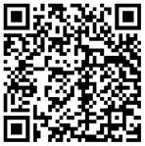


Data integration and survival time prediction models in cancer studies
Dimitar Vassilev and Iliyan Mihaylov

Slide 2
Agenda
Problem Description
Horizontal data integration
Vertical data integration - internal relations and linked data
Classification and normalization with k-neighborhood approach
Survival time prediction, based on novel feature with several machine learning models (SVR- with three kernels – RBF, Linear, Poly and Decision Tree Regression)
Cross validation

Slide 3
Problem Description
Efficient data integration combining gene expression, CNV/CNA, and clinical records from two different diseases : Neuroblastoma and Breast Cancer:
Horizontal data integration – semi structured : same type of records generated from different sources: clinic, HT technologies: GE.
Vertical data integration – combine and build relations between different type of data – (patients, clinical and expression profiles)
Accurate applying of survival time prediction models

Slide 4
Horizontal data integration
Ensembl, UniProt, GO
MongoDB
BUILDING- SEMI-STRUCTURE {AGE_AT_DIAGNOSIS}
building a semi-structure for further analysis
store all raw data from two different diseases in one data store with schema less structure
Completes the missing expression profiles data from different applied HTS sources and relates it to a patient record
Data Preparation (Python - Program Module)
NPI, AGE_AT_DIAGNOSIS,
BREAST_SURGERY,
………
AGE_AT_DIAGNOSIS,
CHEMOTHERAPY,
HUGO_SYMBOL
………
Neuroblastoma RAW data
Breast Cancer RAW data

Slide 5
MongoDB data structure
Different document collection for each type of data
Expression Profile
Clinical data
CNV/CNA
Total Number of documents – 25 603 076 (with all detailed expression profiles) for neuroblastoma and 13 620 for breast cancer (very unbalances data sets)
Indexing of all fields from generated semi-structure – this structure is necessary for building a relationships between records

Slide 6
Vertical Data integration
Ensembl, UniProt, GO
Build internal realtionships based on raw data dependencies (patient-clinical data) (patient-mutation)
(patient-expression)
……….
Finding a additional info about the proteins, their annotation and their relationships
Store all relationships in graph based database. Each record is connected to MongoDB with 128 bits identification
MongoDB
Build INTERNAL relationships between patients, proteins, and CNA/CNV
Build LINKED relationships between proteins, patients and CNA/CNV
Neo4j

Slide 7
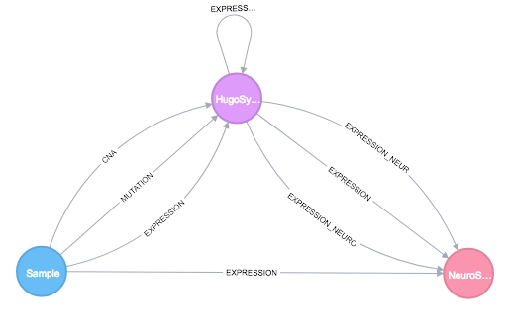
Neo4j data structure
Generated relationships
Store all relationships between entities with small set of attributes (the semi-structure). The full set of attributes are continues to store in MongoDB.
Store Linked data with generated URLs which refer to external domain knowledge sources
Reducing the redundancy: relationships between almost all proteins (more than 1 000 000 000 relations) for the studied datasets: NB and BC.

Slide 8
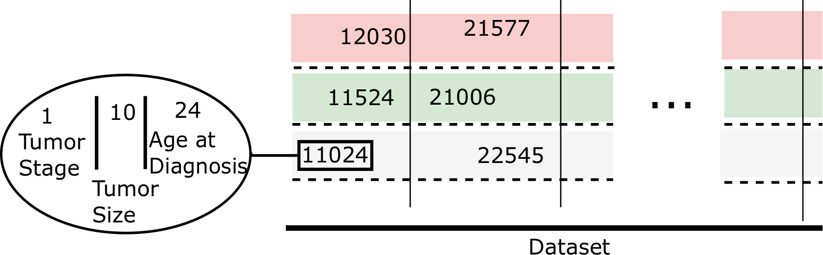
Classification and normalization with k-neighborhood approach
Generate groups based on Tumor Integrated Clinical Feature (TICF) including three attributes
Tumor stage
Tumor size
Age at diagnosis
Applying standard deviation for data normalization and k-neighborhood approach for clustering

Slide 9
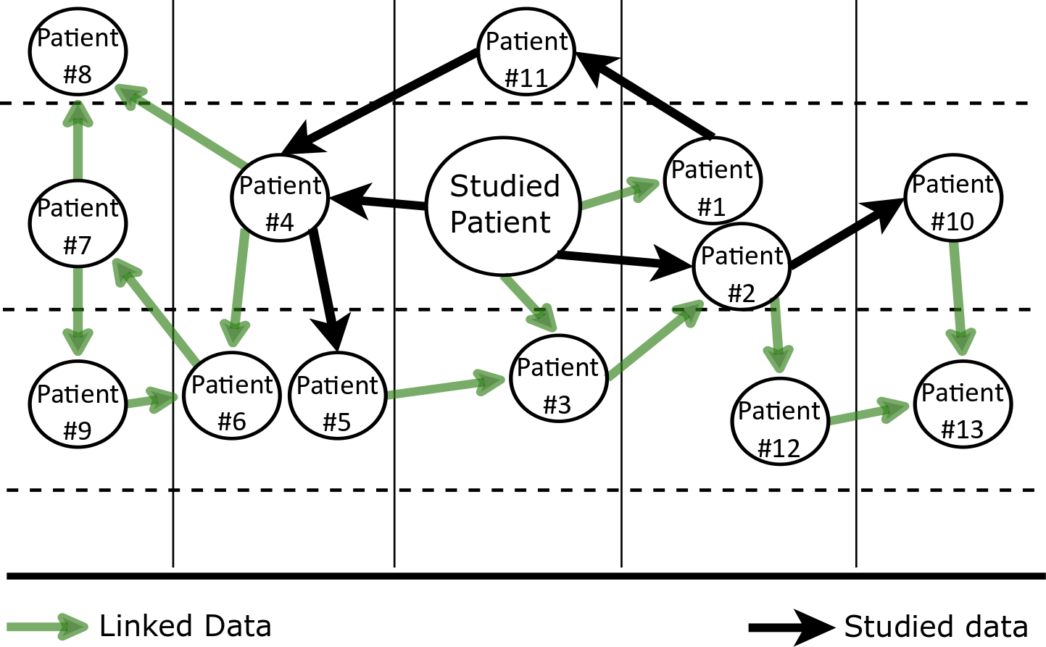
Example for a studied patient

Slide 10
Survival Time Prediction
Input parameters – tumor stage, tumor size, age at diagnosis and for more correctness existing mutations for each particular patient
Find correct group of related patients – using internal relations and linked relations (with suitable amount of data for ML)
Get only relations based on highest score generated from previous iterations
Applying several machine learning models

Slide 11
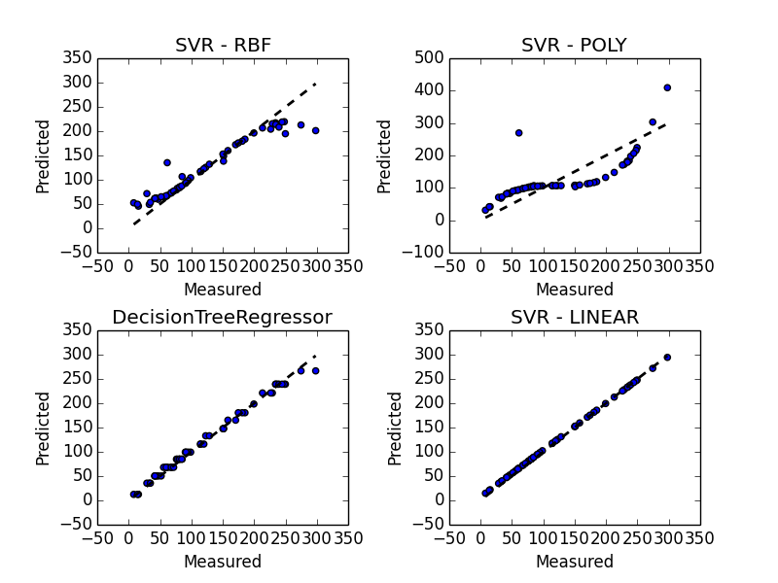
Survival Time Prediction results
Support Vector Regression (SVR):
RBF kernel
Linear kernel
Polynomial kernel
Decision tree regression (DTR)
Support vector regression with linear kernel and DTR show most accurate results

Slide 12
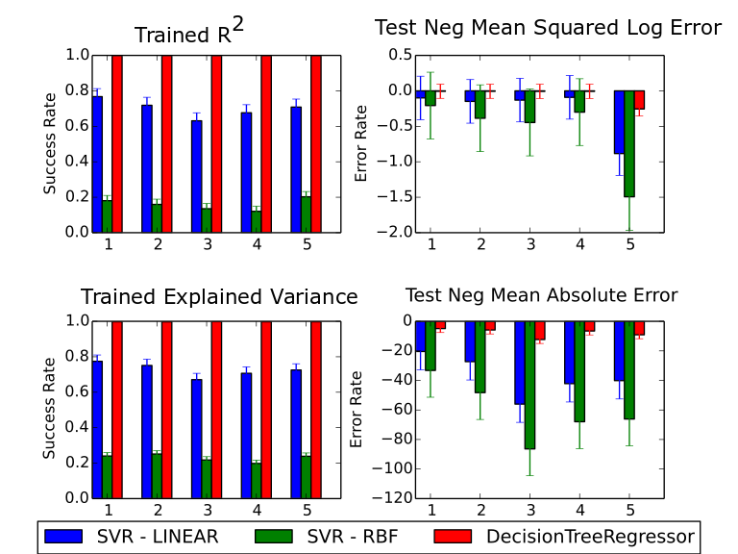
Validation of Survival Time Prediction results
Cross-validation, based on 4 parameters for error evaluation:
trained R² (CD),
negative mean square log error, explained variance,
negative mean absolute error.
The R² and the explained variance are related to the accuracy of the used model, while the two others are related to the noise (error) level.
SVR-linear and DTR models are more suitable for accurate survival prediction

Slide 13
Conclusions
By using two different NoSQL databases we obtained good control and performance for whole data management by not losing any information.
The used vertical and horizontal approaches for data integration provide semantically enriched dataset.
The used tumor integrated clinical feature (TICF) provided better semantic balance of the data for further use of ML models for tumor survival time prediction.
The applied machine learning models give similar tendency of accuracy of survival time prediction.
Semantic DI and STP are amalgamated through an integral environment based on linked data: patients – proteins - patients.

Slide 14
Thank you
&
Questions
dimitar.vassilev@fmi.uni-sofia.bg

